Slide 1
Motion Planning:
Rapidly-Exploring Random Trees
Adrian Sieler, adrian.sieler@tu-berlin.de
Notes:
Welcome to the final tutorial for the course.
This tutorial will be on motion planning and specifically sampling based motion planning,
and we are going to focus on RRTs.
You will implement your own version of the RRT in the assignment

Slide 2
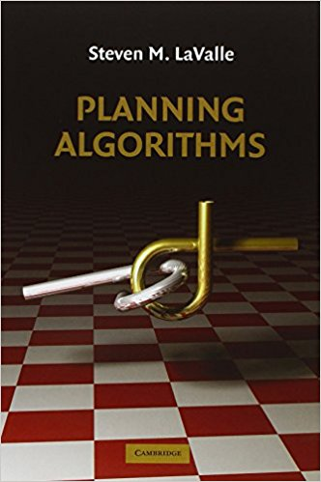
Book recommendation
Available for free - online!
Chapter:
Sampling-based
Motion Planning
http://planning.cs.uiuc.edu/
Notes:
What are the advantages of sampling based?
No explicit construction of Cobst
Do not construct the C-space
apply easily to high-dimensional C-space
support fast queries w/ enough preprocessing

Slide 3
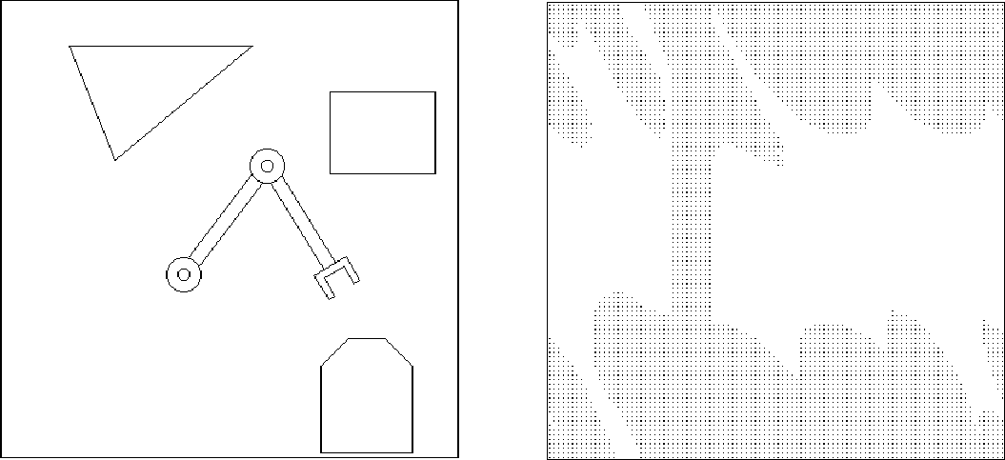
Motion planning
?
y
q2
?
x
q1
Notes:
Workspace is well defined and you can clearly see the obstacles
But the only thing you can control is the joints of the robot
Second figure In this you clearly see the joint space and you know how to move from A to B
But it is difficult to construct the obstacle space

Slide 4
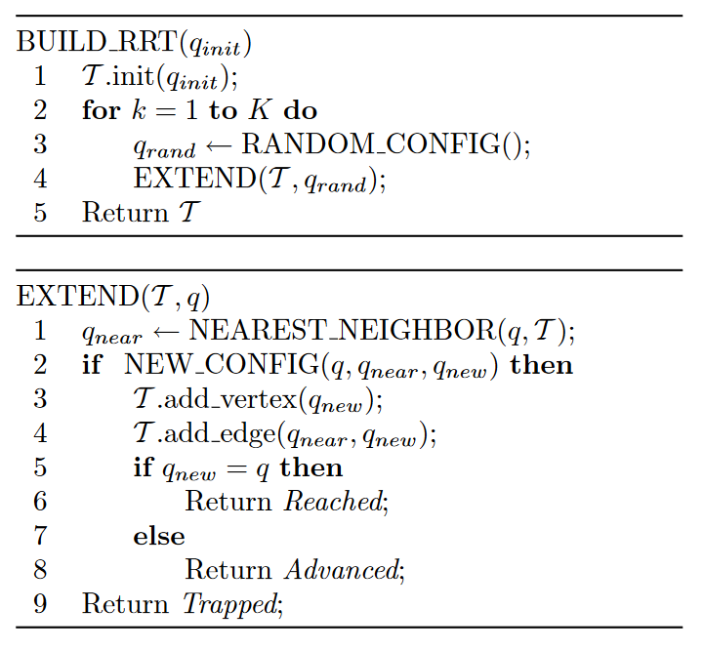
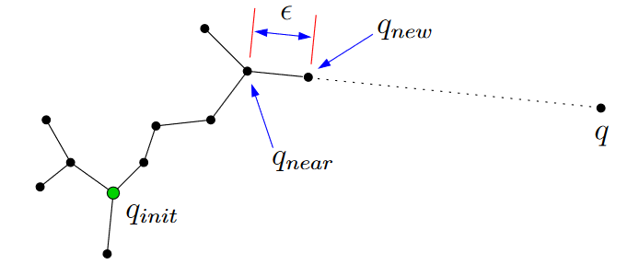
Rapidly-Exploring Random Trees

Slide 5
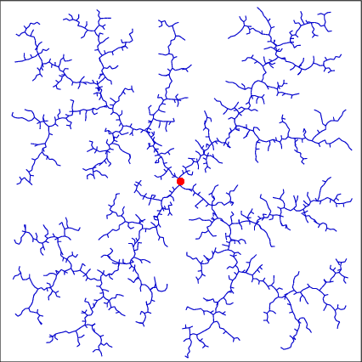

Rapidly-Exploring Random Trees
Sampling based - no fixed grid needed
Explores free space rapidly (Voronoi bias)
Can handle differential
constraints
Probabilistic complete
Notes:
The larger the voronio cell, the greater is the probability of the tree to expand in that direction

Slide 6
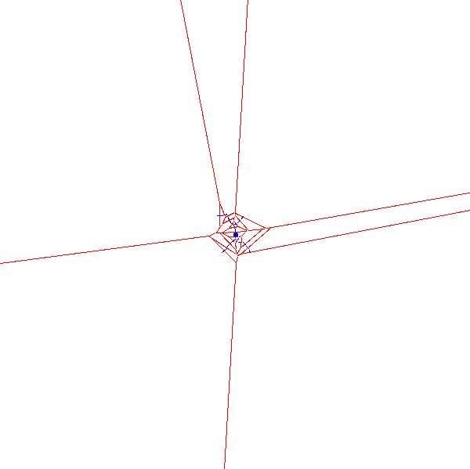
Voronoi Bias
Notes:
Questions?

Slide 7
Exploration versus Exploitation
Exploration seeks understanding of the state space, irrespective of a particular task.
In motion planning, the process exploration seeks to understand the connectivity of the configuration space, irrespective of solving a particular motion planning problem.
Guided exploration seeks efficient understanding of the state space, irrespective a particular task, by leveraging available information.
Exploitation strives to accomplish a particular task as efficiently as possible by leveraging available information.
In motion planning, exploitation seeks a valid path for a particular task, based on available information.

Slide 8
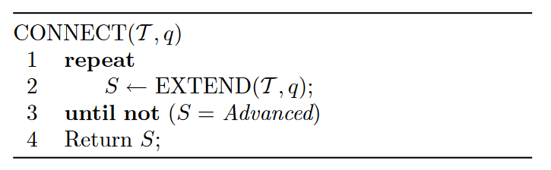
RrtGoalBias/RrtCon
Rrt
RrtGoalBias
: uses the goal instead of qrand in each
iteration with some probability
RrtCon
: uses CONNECT instead of EXTEND

Slide 9
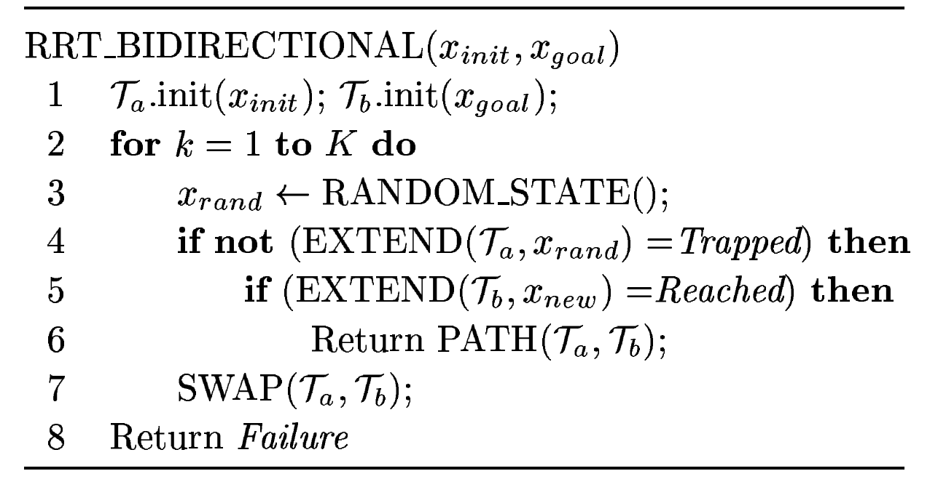
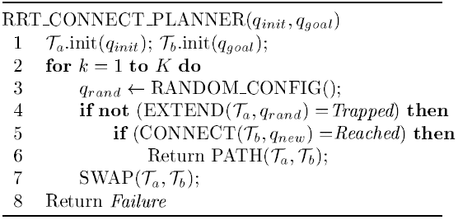
Using two trees
RrtDual
RrtExtCon
RrtExtExt
: replaces CONNECT by EXTEND
RrtConCon
: replaces EXTEND by CONNECT
Notes:
You extend one tree with a randomnly sampled node and you extend the other tree towards the new node added in the other tree

Slide 10
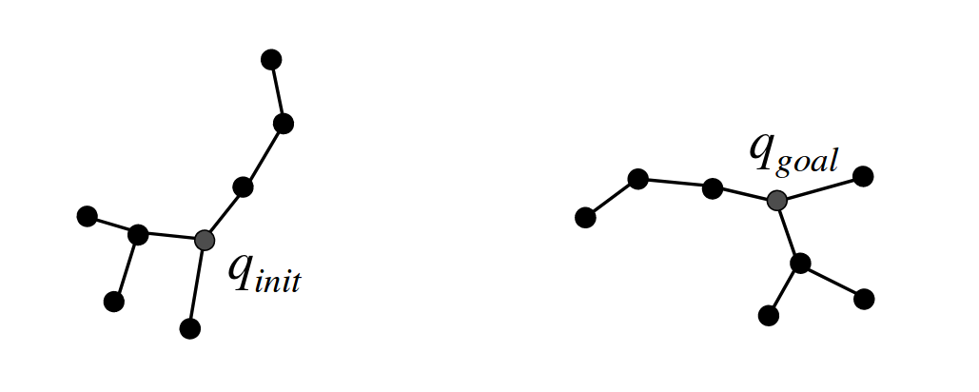
Bi-directional RRT Connect (RRTConCon)

Slide 11
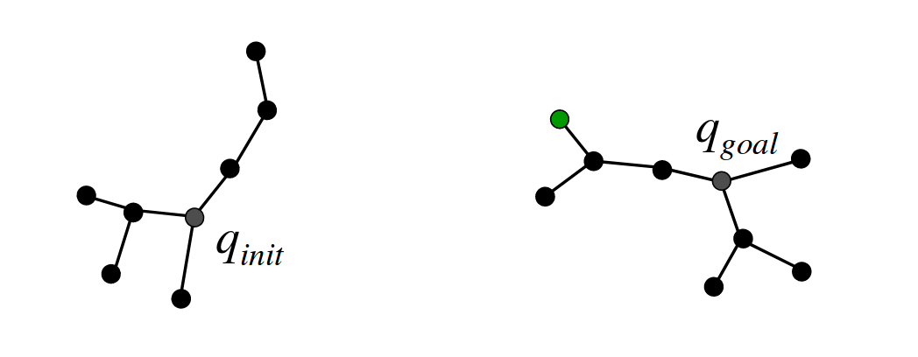
Bi-directional RRT Connect

Slide 12
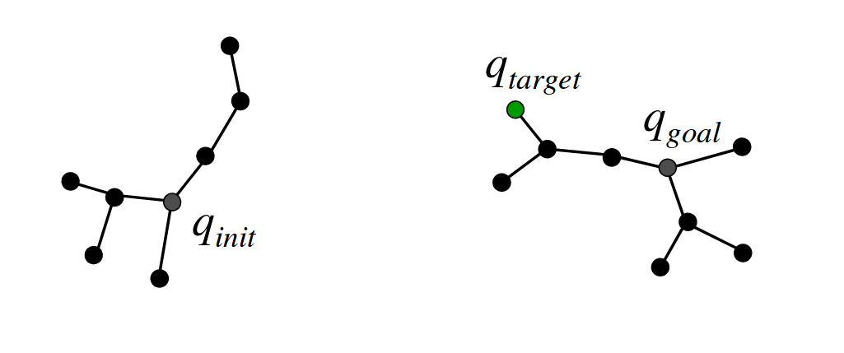
Bi-directional RRT Connect

Slide 13
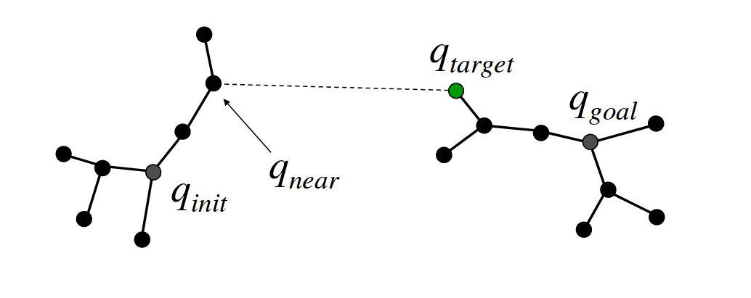
Bi-directional RRT Connect

Slide 14
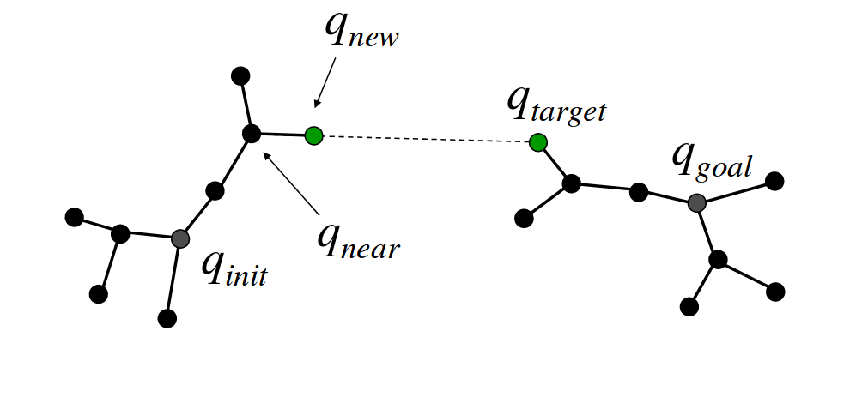
Bi-directional RRT Connect

Slide 15
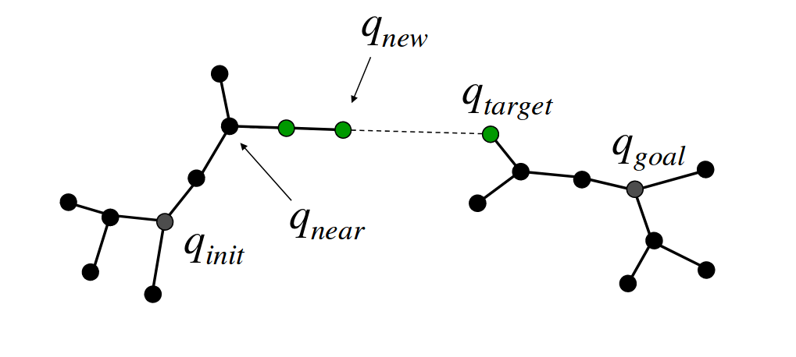
Bi-directional RRT Connect

Slide 16
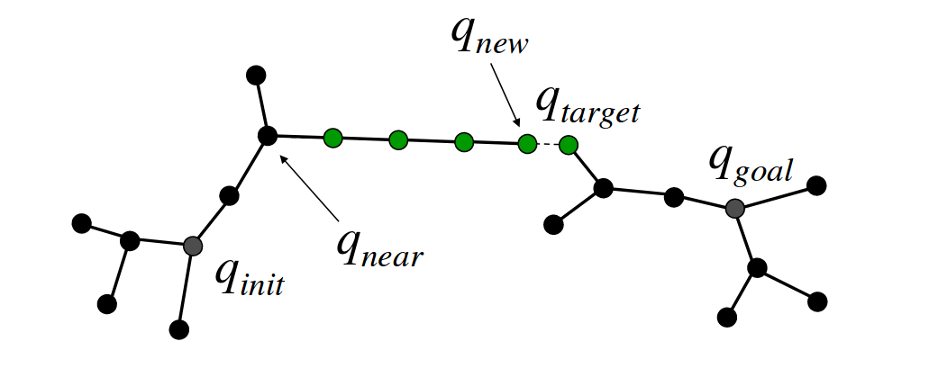
Bi-directional RRT Connect

Slide 17
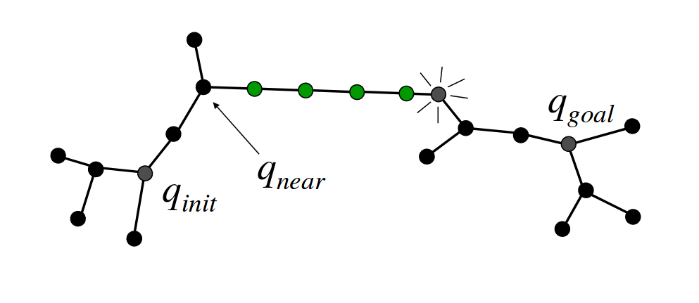
Bi-directional RRT Connect

Slide 18
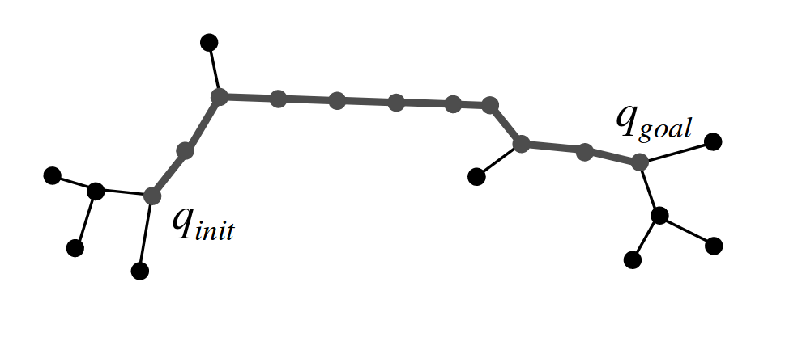
Bi-directional RRT Connect
Notes:
Questions?
RRT - Sample, connect
BiRRT - Sample, connect, new node becomes target for the other tree, connect
The trees also swap their roles

Slide 19

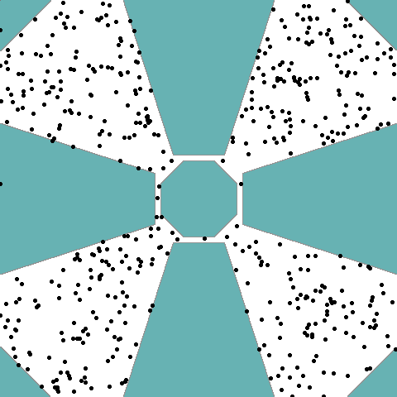
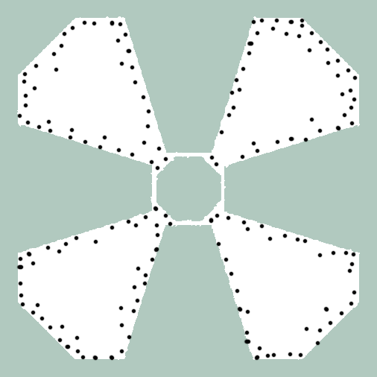
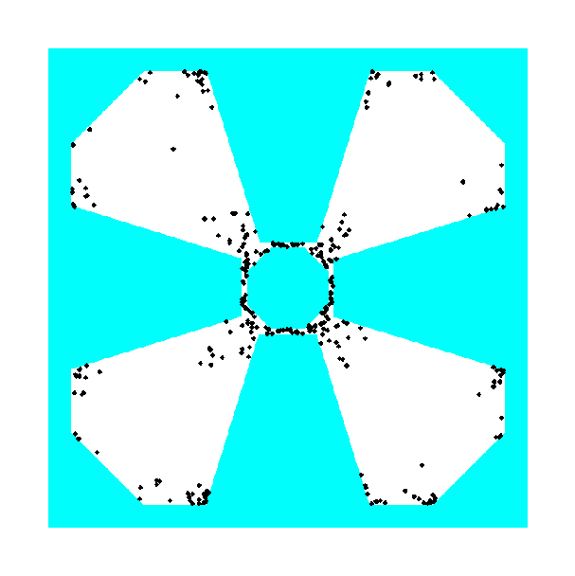
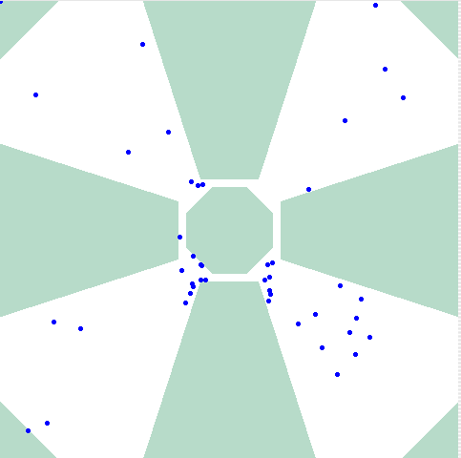
Different Sampling Strategies
ideal
uniform
Gaussian
Bridge
Utility

Slide 20
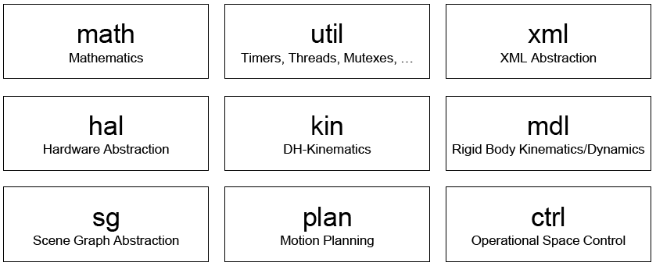
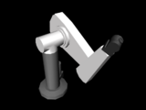
Robotics Library: www.roboticslibrary.org
A framework for developing robotics applications
Pro: All models we need are already included
Con: only sparse documentation
(there are doxygen docs)
Notes:
Show the assignment here

Slide 21
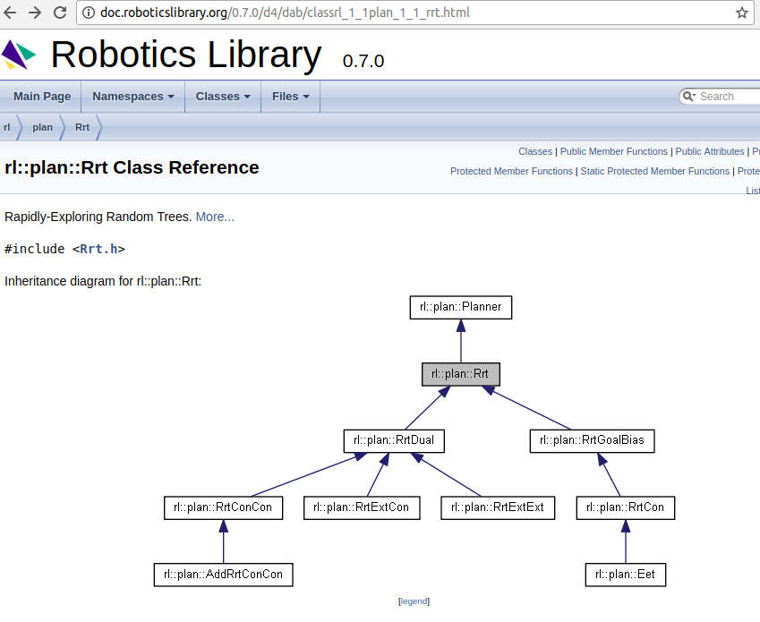

Slide 22
You can easily install RobLib on Ubuntu
Install prerequisites
  sudo add-apt-repository ppa:roblib/ppa
  sudo apt-get update
  sudo apt-get install librl-dev
  Download and extract tutorialPlan.zip:
  tar xfz tutorialPlan.zip
Build
  cd tutorialPlan/build
  cmake ..
  make
Test:
  cd tutorialPlan/build
  ./tutorialPlan - Press space to start planning, F12 to reset
You might want to check out the instructions on the wiki:
[ courses.robotics.tu-berlin.de/
mediawiki/index.php/RobLibInstallation
?]
https://www.roboticslibrary.org/tutorials/install-ubuntu/
Notes:
Show them the RLlib and tutorial plan here

Slide 23
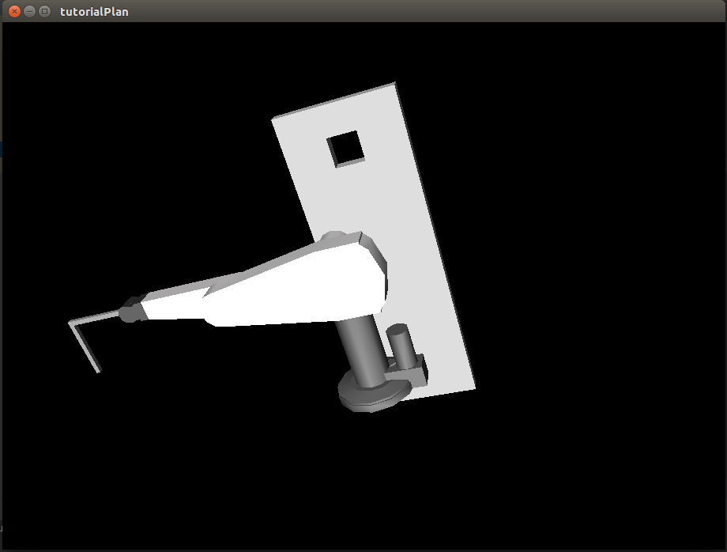
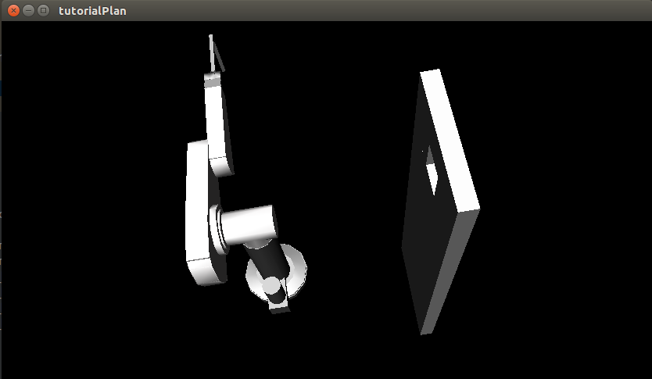
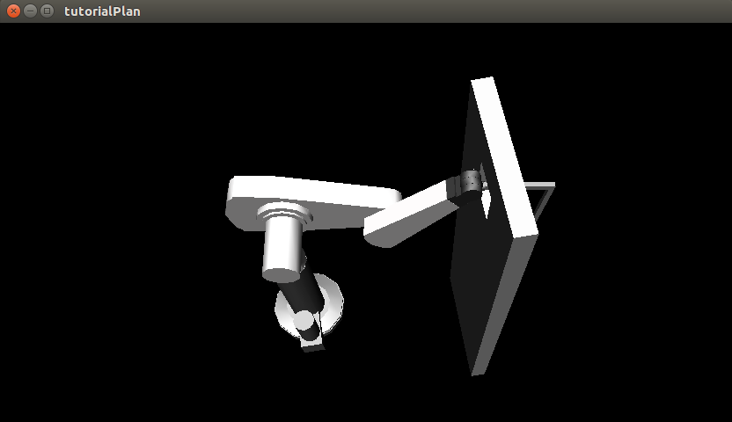
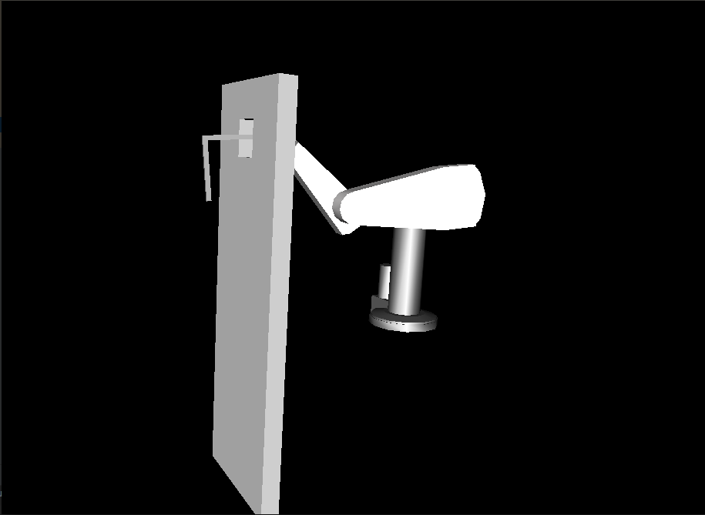
Puma Environment
Start Configuration
Goal Configuration
https://www.roboticslibrary.org/tutorials/install-ubuntu/
Notes:
Show them the RLlib and tutorial plan here

Slide 24
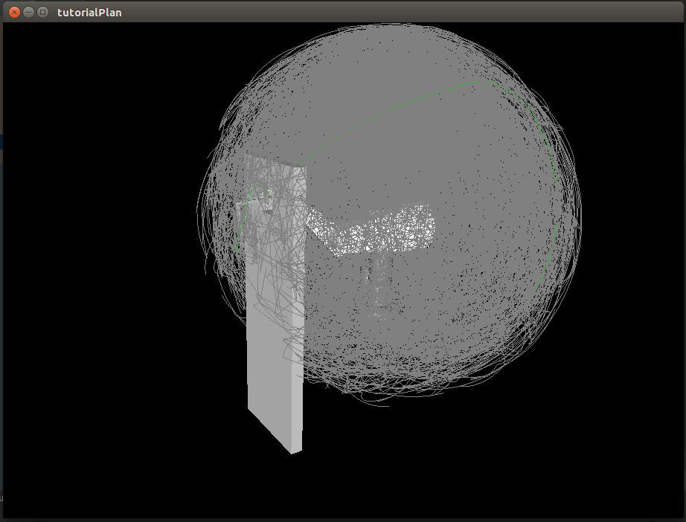
Puma - Motion Planning Execution (1)
https://www.roboticslibrary.org/tutorials/install-ubuntu/
Notes:
Show them the RLlib and tutorial plan here

Slide 25
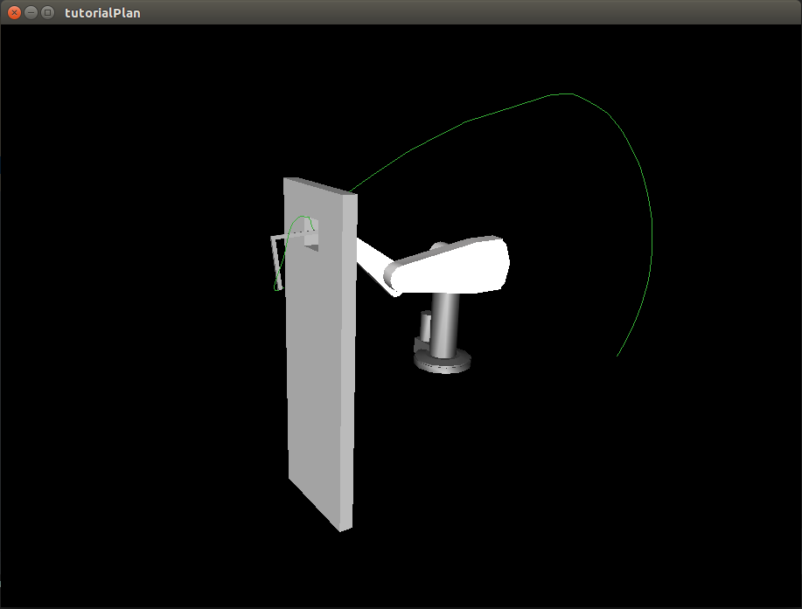
Puma - Motion Planning Execution (2)
https://www.roboticslibrary.org/tutorials/install-ubuntu/
Notes:
Show them the RLlib and tutorial plan here

Slide 26
Windows (VS2010) installation is also possible
Install prerequisites
  Install Visual Studio 2010 (Express is fine)
  Install Cmake
  Install Qt http://download.qt-project.org/archive/qt/4.8/4.8.5/qt-win-opensource-4.8.5-vs2010.exe
  Install roblib http://www.roboticslibrary.org/tutorials/install-windows follow all instructions on the page!
  Download and extract tutorialPlan.zip:
Build:
  Open tutorialPlan/CMakeLists.txt in CMake - generate Visual Studio 10 project files in the build directory
  Open build/tutorialPlan.sln in Visual Studio 2010
  Compile RelWithDebInfo (Debug is not supported - sorry)
Test:
  press F5 or open build/RelWithDebugInfo/tutorialPlan.exe - Press space to start planning, F12 to reset
You might want to check out the instructions on the wiki:
[ courses.robotics.tu-berlin.de/
mediawiki/index.php/RobLibInstallation
?]

Slide 27
Hierarchy of RRT Classes for assignment
rl::plan::Planner
Copied from roblib classes plus some comments
solve(), getPlan()
RrtConConBase
choose(..), nearest(..), ,extend(..), connect(..), vector<Tree> tree
TODO
YourPlanner

Slide 28
Hierarchy of RRT Classes in rl::plan
Planner
solve(), getPlan()
Instead of sampling randomly it chooses the goal with probablity p
Grows two trees (from goal and start configuration)
Rrt
choose(..), nearest(..), ,extend(..), connect(..), vector<Tree> tree
RrtGoalBias
RrtDual
choose(..)
RrtConCon
RrtExtCon
RrtExtExt
RrtCon

Slide 29
Writing Your Planner
Modify YourPlanner.cpp
Inherit from RrtConConBase (or any other RRT based planner in rl::plan)
Set parameters of your algorithm in TutorialPlanSystem.cpp
Implement better choose(), connect(), extend(), solve()
You can add parameters for vertices in RrtConConBase::VertexBundle
Notes:
Show the code here

Slide 30
Evaluating your algorithm
Every time you run ./tutorialPlan an entry is added to benchmark.csv
This entry shows: computation time needed to solve the problem, number of nodes and edges created, number of queries needed to construct them, etc.
Take a look into ~/roblib/examples/tutorialPlan/tutorialPlanSystem.cpp to see the details and/or to edit them
Run your algorithm at least ten times! – Change start and goal!

Slide 31
Writing the Documentation
Explanation of the proposed extensions with a code snipped
Reasoning about extensions that have not improved the runtime
Performance evaluation of your final algorithm
(Optional) Extra points can be gained by performing an ablation study of your extensions with regard to the runtime

Slide 32
References
http://roboticslibrary.org
Robotics library examples: https://github.com/roboticslibrary/rl-examples
Introduction to RRTs: msl.cs.uiuc.edu/rrt/
Planning Book: Sections in 5.5 and 14.4 in planning.cs.uiuc.edu
RRTExtCon: http://msl.cs.uiuc.edu/~lavalle/papers/KufLav00.pdf
Avoid exhausted Nodes: http://homepages.laas.fr/jcortes/Papers/icra07paper.pdf
Avoid Voronoi bias: http://ieeexplore.ieee.org/iel5/10495/33250/01570709.pdf

Slide 33


